Slide 2
About Today…
Creating basic express server
Details of different parts
JSON
JSON in express

Slide 3
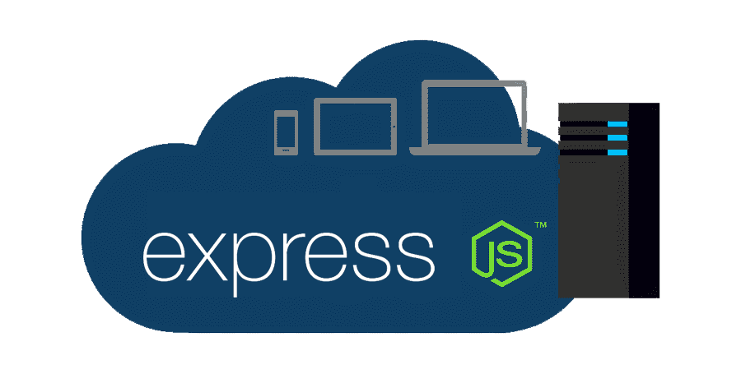

Slide 4
Initial Steps
Install node.js
npm init -y
package.json
npm install express

Slide 5
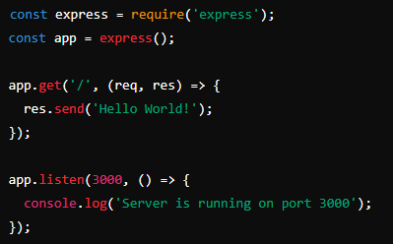
Server detail
Import Express at the top of the file
Create an instance of the Express application
Define a route handler for the root URL ('/‘)
Send response to display a message when the root URL is accessed
Let the server listen
Listen on a specific port

Slide 6
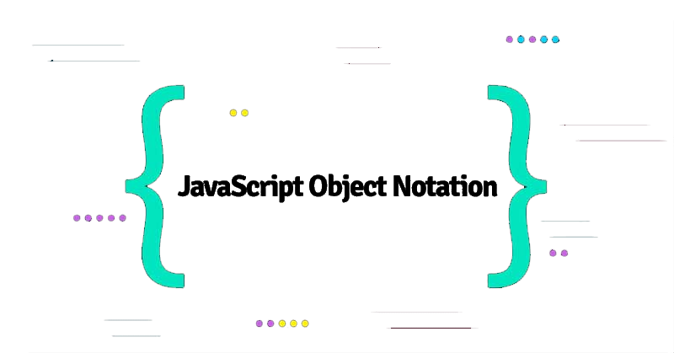
Intro to JSON
JSON stands for JavaScript Object Notation
It is a lightweight data-interchange format
Easy for humans to read and write
Easy for machines to parse and generate
Based on a subset of JavaScript, but language-independent

Slide 7
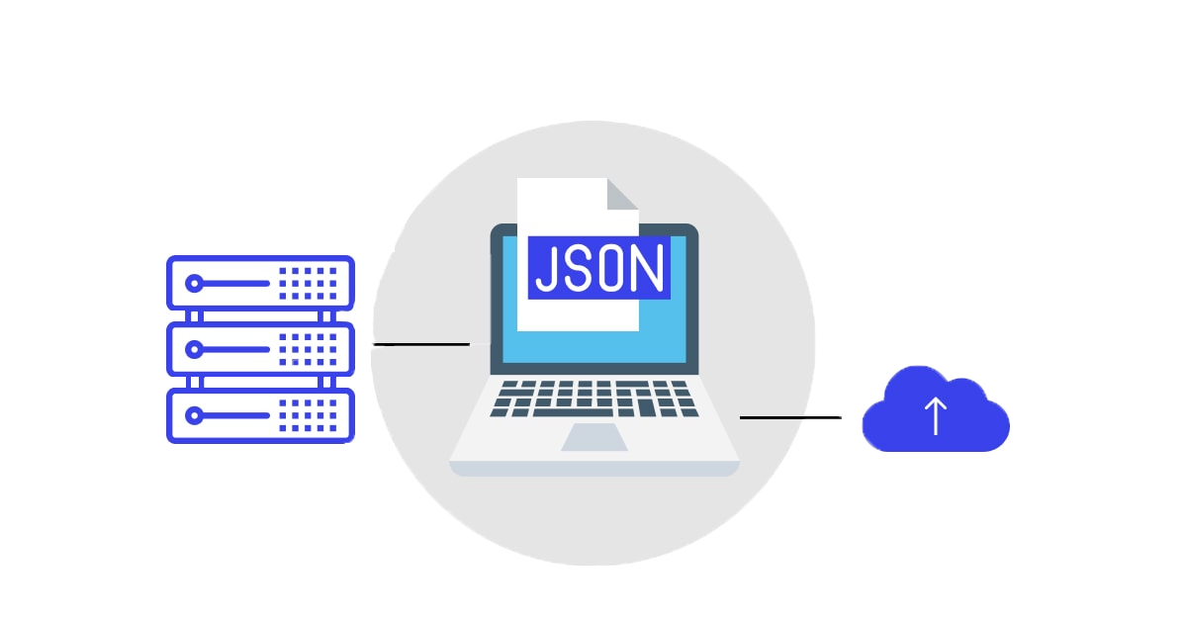
Why JSON is Needed
Interoperability
Widely used for data exchange between different systems and platforms
Efficiency
Lightweight and fast compared to XML
Readability
Easy to understand and edit by humans
Integration
Commonly used with web APIs and modern web services

Slide 8
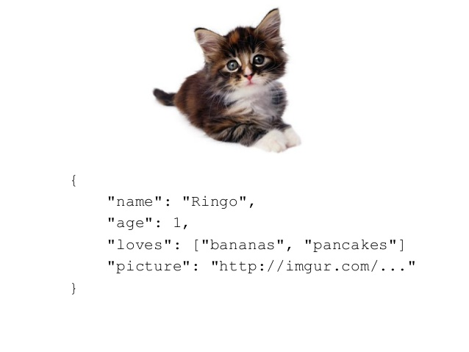
JSON Structure
Objects
Key-value pairs enclosed in curly braces { }
Arrays
Ordered lists of values enclosed in square brackets [ ]
Values
Can be strings, numbers, objects, arrays, true, false, or null

Slide 9
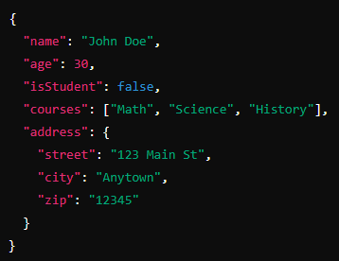
Example of JSON
Objects
Arrays
Values
JSON Object containing all of the above

Slide 10
How JSON is Used in Websites
Data Transfer
Commonly used to transfer data between client and server
APIs
Frequently used in web APIs for data exchange
Configuration
Often used for configuration files in various applications
Storage
Used in databases like PostgreSQL, MongoDB etc

Slide 11
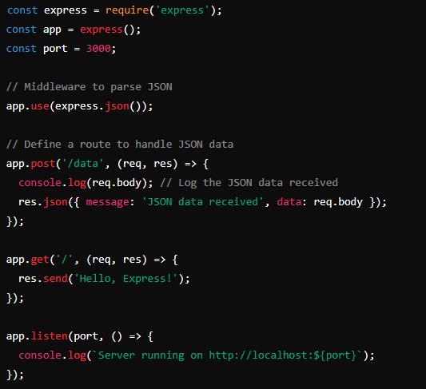
JSON with Express.js
Express.js provides middleware to
handle JSON data
You can easily parse and respond with
JSON data

Slide 12
